Slide 1
Design Basics
J187 Introduction to Interactive Multimedia
IIMM
Introduction
Color
Type
J187 Class 2

Slide 2
Problem Solving
Design is about:
Communication
Creating Interest
Solving Problems
Visual or Design Element:
Anything on the page as well as the lack of anything (space).
Images, text, lines, shapes, graphics, spacing, etc.

Slide 3
CRAP Design
C.R.A.P:
Contrast
Repetition
Alignment
Proximity

Slide 4


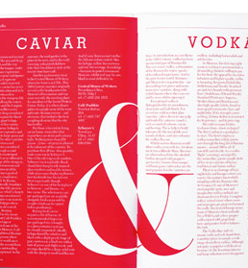
Contrast
Use colors, shapes, sizes, fonts, space and imagery to create contrast in design.
Avoid colors and typefaces that are similar.

Slide 5
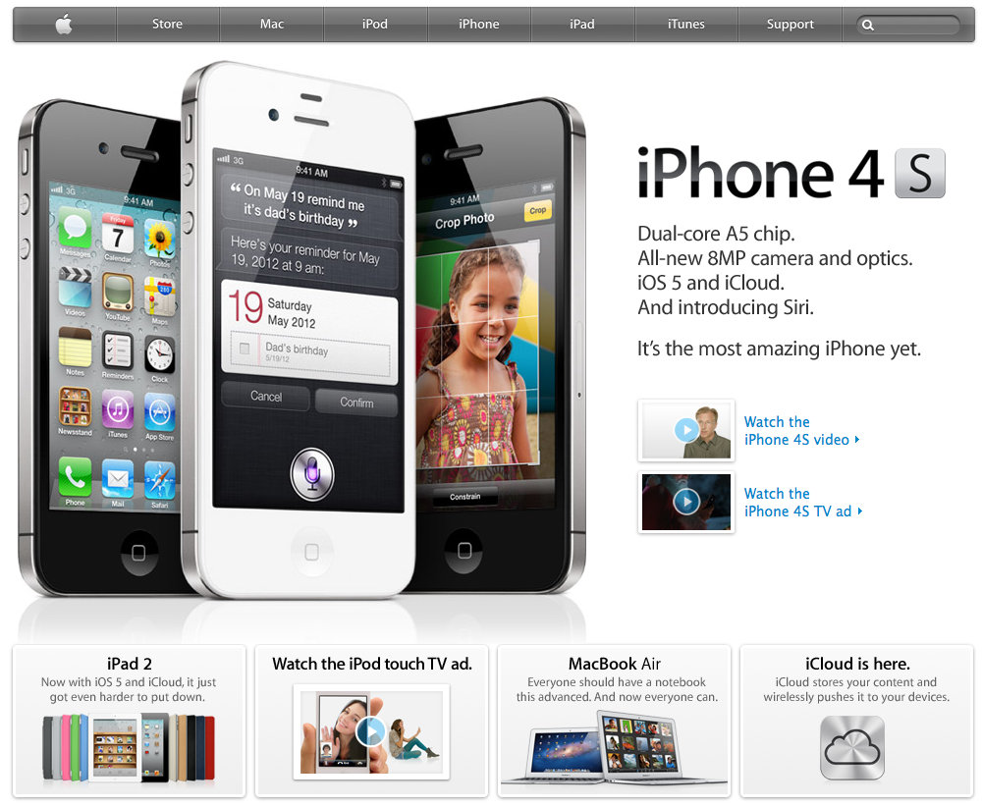

Slide 6

Repetition
Repeat visual elements throughout the design
Communicates consistency and brand

Slide 7


Slide 8
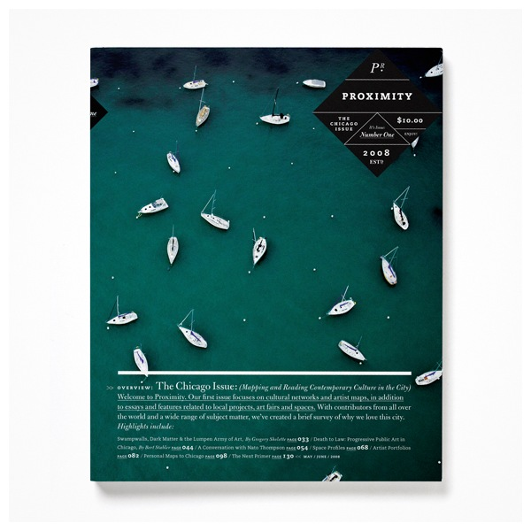

Alignment
Where’s my boat?
Dock 4, Slip 20.

Slide 9
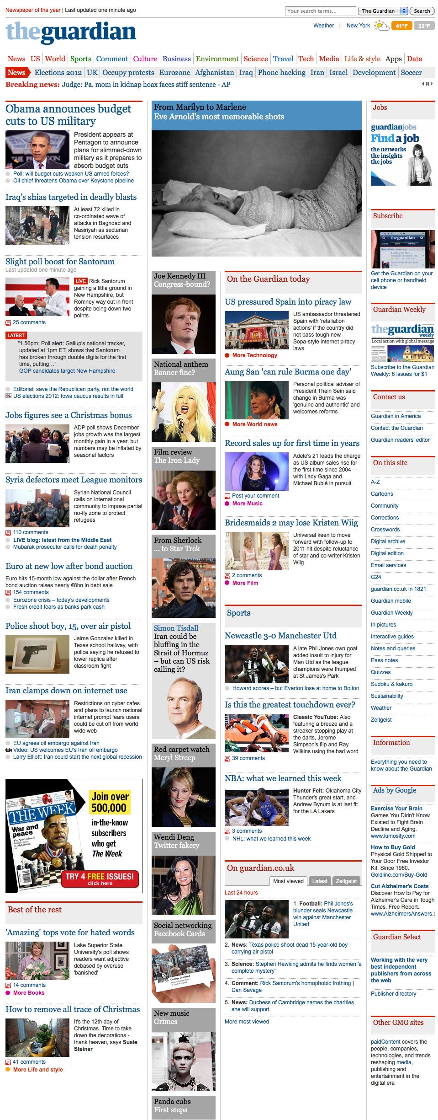

Slide 10
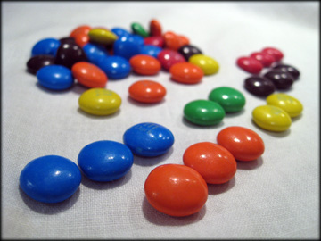

Proximity
Similar Items Closer, Different farther apart.

Slide 11
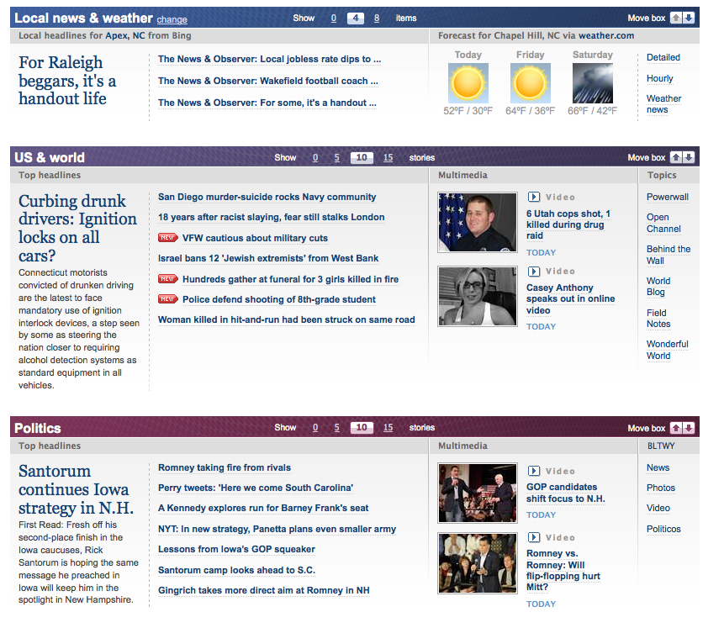

Slide 12

Color

Slide 13
CMYK or RGB?
CMYK
RGB
For Print
Pigment
DO NOT USE IN CLASS!
For Screens
Light
ALWAYS USE IN CLASS!
WE WILL NEVER USE OR SPEAK OF CMYK IN THIS CLASS AGAIN!

Slide 14
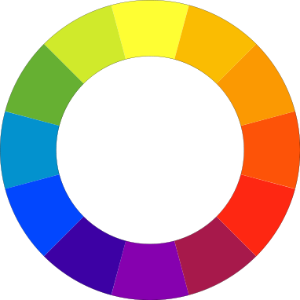
Color Wheel

Slide 15
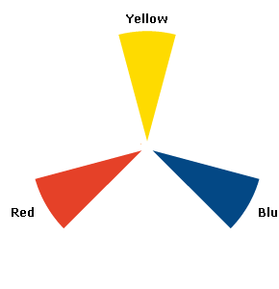
Primary Colors
Wheel is based on the equal spacing of the primary colors Red, Yellow and Blue

Slide 16
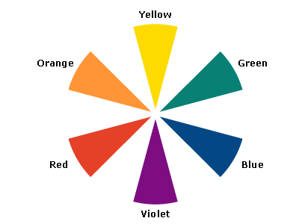
Secondary Colors
Equal combinations of those primary colors
Orange, Green, Violet/Purple

Slide 17
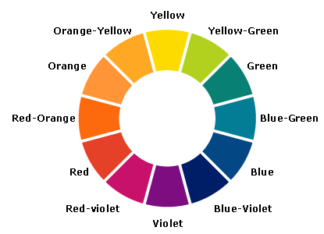
Tertiary (third) Colors
The next level of equal combinations
The color blue-green for example.

Slide 18
Color Relationships
Complementary
Two opposite colors in wheel
Triads
Triangle Spacing around wheel
Analogous
Adjacent Hues
Monochromatic
Single color, varied intensity
Compound
Combines colors from various hues

Slide 19
Color Relationships
Complementary
Two opposite colors in wheel
Triads
Triangle Spacing around wheel
Analogous
Adjacent Hues
Monochromatic
Single color, varied intensity
Compound
Combines colors from various hues

Slide 20
Color Relationships
Complementary
Two opposite colors in wheel
Triads
Triangle Spacing around wheel
Analogous
Adjacent Hues
Monochromatic
Single color, varied intensity
Compound
Combines colors from various hues

Slide 21

Color Relationships
Complementary
Two opposite colors in wheel
Triads
Triangle Spacing around wheel
Analogous
Adjacent Hues
Monochromatic
Single color, varied intensity
Compound
Combines colors from various hues

Slide 22

Color Relationships
Complementary
Two opposite colors in wheel
Triads
Triangle Spacing around wheel
Analogous
Adjacent Hues
Monochromatic
Single color, varied intensity
Compound
Combines colors from various hues

Slide 23
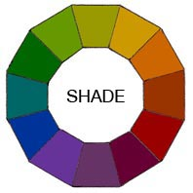
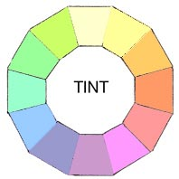
Shades and Tints
Add Black
Add White

Slide 24


Warm and Cool Colors
Warm
Cool

Slide 25
Color Scheme Selection
http://kuler.adobe.com/#themes/rating?time=30
http://colorschemedesigner.com/
Image Selection in Photoshop

